Slide 1
Micro-Electro Mechanical Systems (MEMS)

Slide 2
MEMS
Micro Electrical Mechanical Systems
Practice of making and combining miniaturized mechanical and electrical components
“Micromachines” in Japan
“Microsystems Technology” in Europe

Slide 3
Outline
Introduction
Fabrication Technologies
Applications
Applications in defense department
Advantages and Disadvantages
Conclusions

Slide 4
Introduction
MicroElectroMechanical is the technology of the very small, and merges at the nano-scale into nanoelectromechanical systems (NEMS)
MEMS based sensor products provide an interface that can sense, process and/or control the surrounding environment.
sensors are a class of devices that builds very small electrical and mechanical components on a single chip.
sensors are a crucial component in automotive electronics, medical equipment, hard disk drives, computer peripherals,wireless devices and smart portable electronics such as cell phones and PDAs.

Slide 5
FABRICATION TECHNOLOGIES
Miniaturization
Multiplicity
Microelectronics

Slide 6
APPLICATIONS OF MEMS
Pressure sensor
Accelerometers
Inertial Sensors
Microengines

Slide 7
MEMS technology creates personal navigation device for defense department
Guidance and navigation have been critical for military success since the dawn of civilization.
Accuracy was the focus of earlier Department of Defense (DoD) navigation research, and led to the development of the Global Positioning System (GPS).

Slide 8
The current focus in the DoD is the development of portable localization systems, particularly for GPS-denied or -compromised environments.
The primary focus of their research is applying personal navigation systems to a situation in which a soldier is dismounted.
In this case, the navigation sensor is placed in the soldier’s shoe or boot sole in order to determine his or her location with high accuracy.

Slide 9
Shoe-Based Sensors: How They Work?
They work on chip-scale inertial sensors that meet the power and size requirements for portable applications. However, they suffer from a rapid growth in position error due to inherent bias drift and noise in the sensors.
To limit this error growth, a RF velocity sensor that detects when a shoe touches the ground.
As seen in the pictures on the following page, three kinds of shoe sensors are implanted in a shoe.

Slide 10
The RF terrain-relative velocity (TRV ) sensor mounted on the heel and toe is used for ZUPting the position computed from the accelerometers in the MEMS-based inertial measurement unit (IMU ).
The magnetometers in the IMU are used for ZUPting the heading computed from the gyroscope on the IMU.
Shoe relative sensors (SRS ) on one shoe form a constellation which can then be used to find the location of a moving shoe with respect to a stationary shoe.

Slide 11
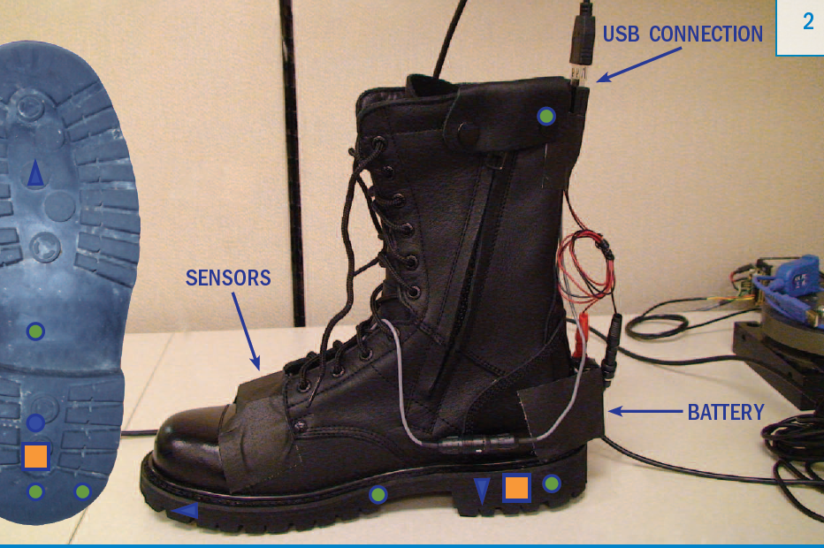

Slide 12
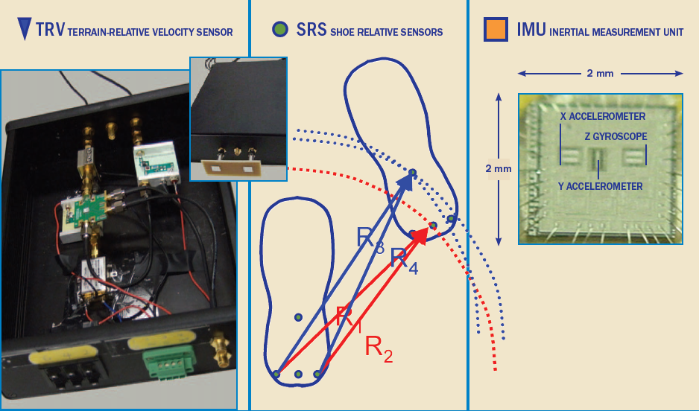

Slide 13
Advantages
Low cost (can even be made “disposable”)
They are useful in the field of defense of a nation
Will work for many machine health applications
Onboard signal conditioning. No charge amplifiers required.

Slide 14
Disadvantages
Performance still below that of more expensive sensors
May not be available in industrial hardened packages

Slide 15
MEMS Features
Low interference with environment
Accurate, Compact, Shock resistant
Inexpensive - based on IC batch fabrication
Use in previously unfeasible domains
Redundancy
Large sampling size, greater data certainty

Slide 16
CONCLUSION
MEMS-based sensors are a crucial component in automotive electronics, medical equipment, smart portable electronics such as cell phones and hard disk drives, computer peripherals, and wireless devices.
These sensors began in the automotive industry especially for crash detection in airbag systems. Throughout the 1990s to today, the airbag sensor market has proved to be a huge success using MEMS technology.
MEMS-based sensors are now becoming pervasive in everything from inkjet cartridges to cell phones. Every major market has now embraced the technology.

Slide 17
THANK YOU…
www.playppt.com

