Slide 1
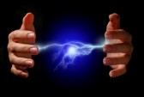
TRANSFORMER CONSTRUCTION
PRESENTED BY
K.SURESH
ASST . PROFESSOR

Slide 2
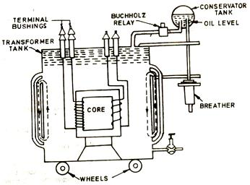
TRANSFORMER MAINLY CONSIST OF
WINDING
CORE
TANK
INSULATIONS
TRANSFORMER OIL
BUSHINGS
CONSERVATOR
BREATHER
COOLING OF TRANSFORMER
BUCHHOLZ RELAY
OIL LEVEL INDICATOR
TEMP INDICATOR

Slide 3
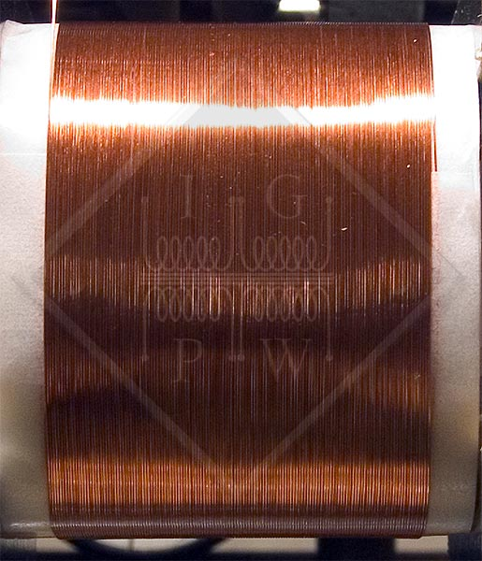
WINDINGS
Types of transformer windings are,
CONCENTRIC
SANDWICH
Disc
Cross over
Helical

Slide 4
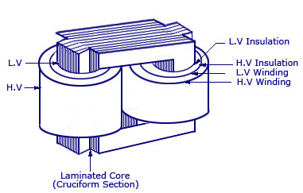
CONCENTRIC COIL

Slide 5
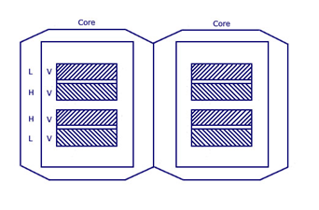
SANDWICH COI L

Slide 6
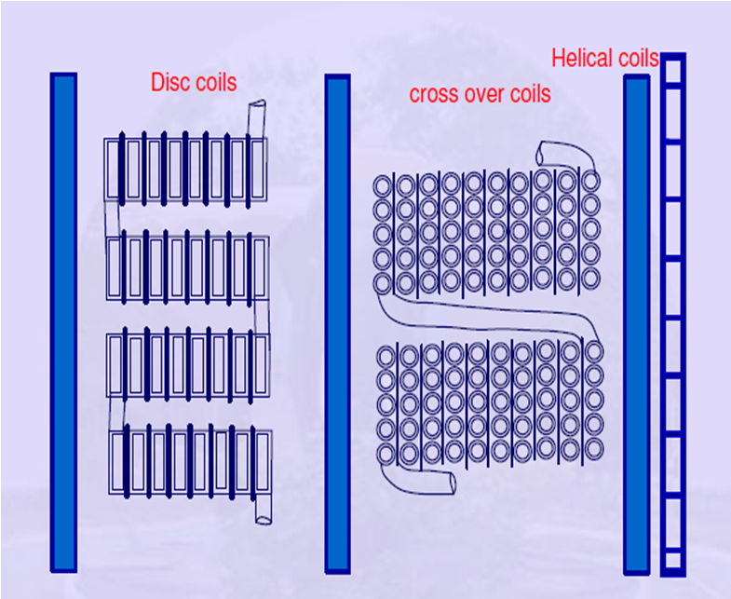
TYPES OF SANDWICHED COILS

Slide 7
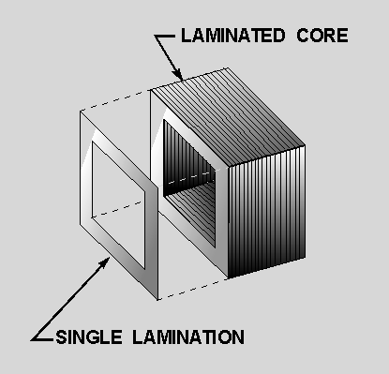
CORE

Slide 8
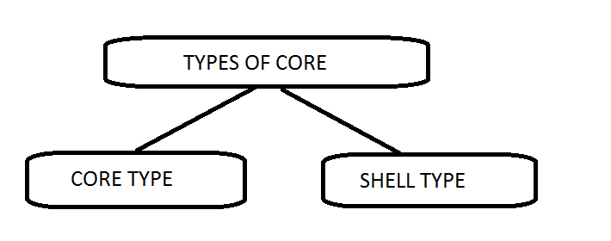
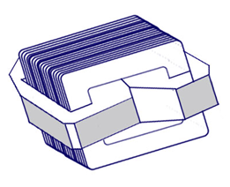
TYPES OF CORE

Slide 9
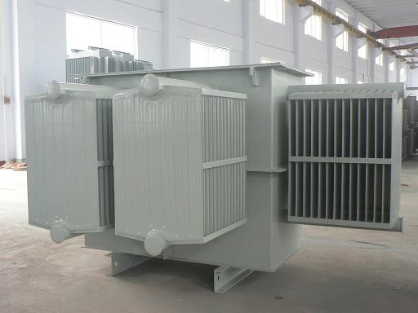
TANK
MADE OF
STEEL AND ALUMINIUM
(power and traction transformers)
MILD STEEL AND ALUMINUM(BESIDE power and traction transformers)

Slide 10
INSULATIONS
Dry type Transformers:
Varnish
Enamel
Large size Transformers:
Unimpregnated paper
Cloths
Immersed in Transformer oil – insulation & coolent

Slide 11
TRANSFORMER OIL
TRANSFORMER OIL SHOULD HAVE
INSULATING PROPERTY
VISCOSITY
PURITY
SLUDGE FORMATION
ACIDITY
HIGH FLASH POINT AND FIRE POINT

Slide 12
BUSHINGS
BUSHINGS CONSIST OF
INSULATOR
ROD

Slide 13
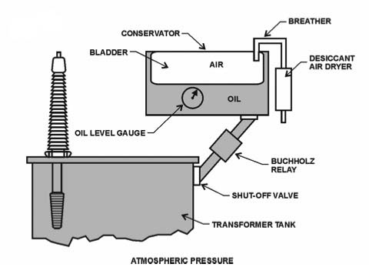
CONSERVATOR

Slide 14
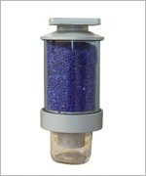
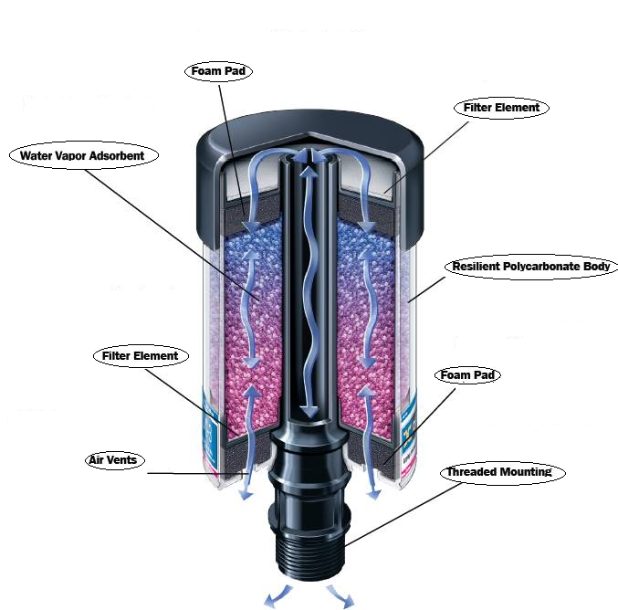
BREATHER

Slide 15
COOLING OF TRANSFORMERS
Methods of cooling:
Air Natural (AN)-upto 1.5MVA
Air Blast (AB)
Oil natural (ON) – Upto 10 MVA
Oil Natural – Air Forced (ONAF)
Oil Forced– Air Natural (OFAN) – 30 MVA
Oil Forced– Air Forced (OFAF)
Oil Natural – Water Forced (ONWF) – Power plants
Oil Forced - Water Forced (OFWF) – Power plants

Slide 16
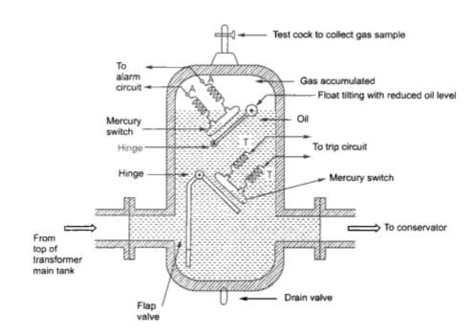
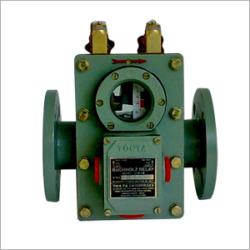
BUCHHOLZ RELAY

Slide 17
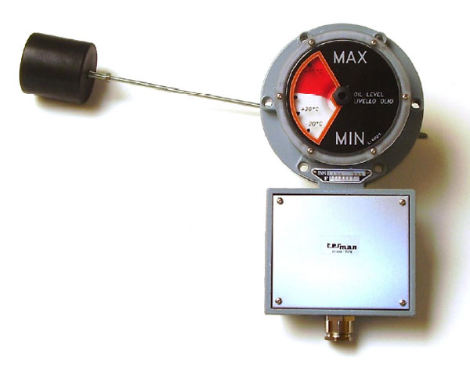
OIL LEVEL INDICATOR

Slide 18
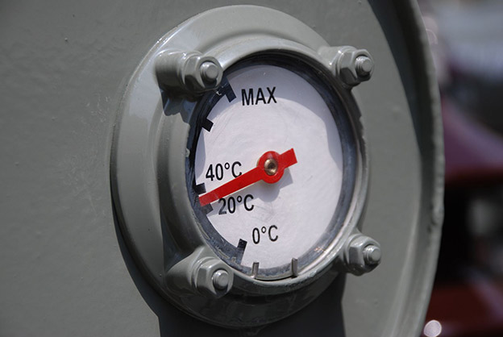
TEMP INDICATOR

Slide 19
THREE PHASE TRANSFRMERS

Slide 20
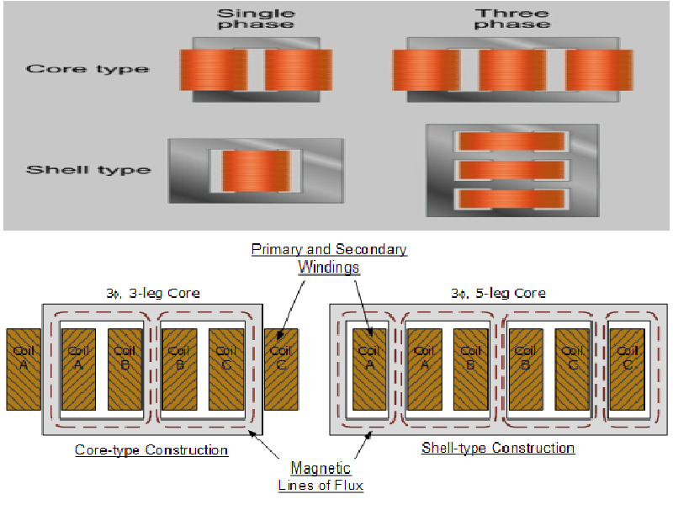
THREE PHASE TRANSFRMERS(1)

Slide 21
THREE PHASE TRANSFRMERS(2)

Slide 22
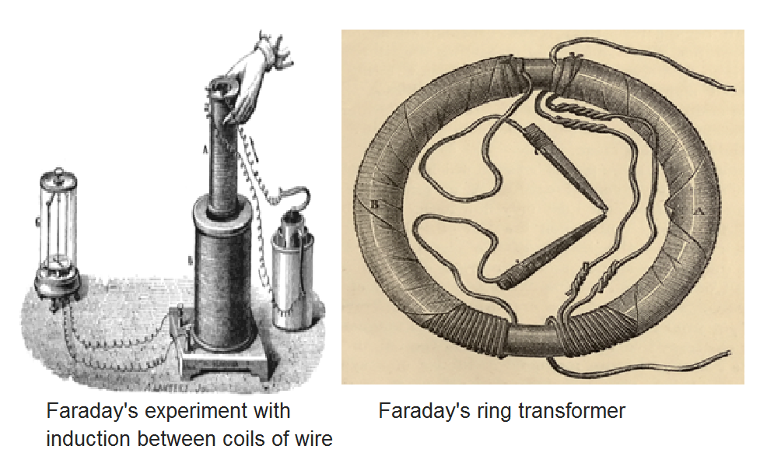
HISTORY OF TRANSFORMER
1885
William Stanley's First Transformer built in 1885

Slide 23
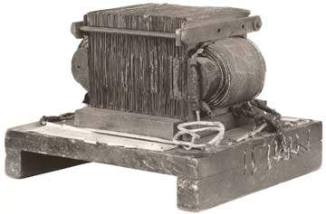
1885
William Stanley's First Transformer built in 1885

Slide 24
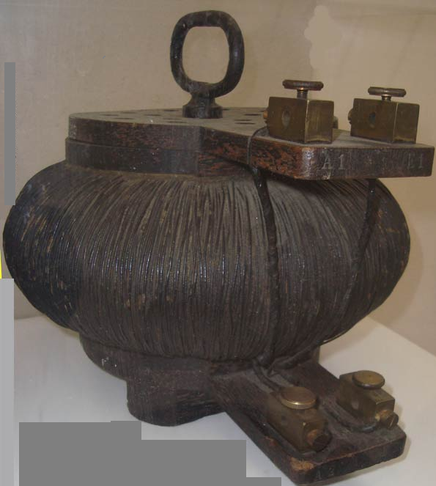
1885
Shell form transformer. Sketch used by Uppenborn to describe ZBD engineers' 1885 patents and earliest articles.

Slide 25
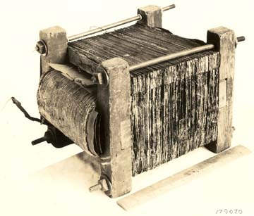
1886
Stanley's first transformer which was used in the electrification of Great Barrington, Massachusetts in 1886

Slide 26
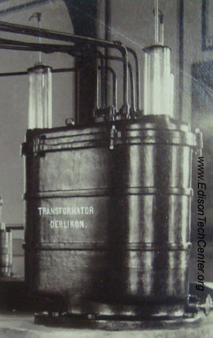
1891
Transformer used on the Lauffen to Frankfurt demonstration line.

Slide 27
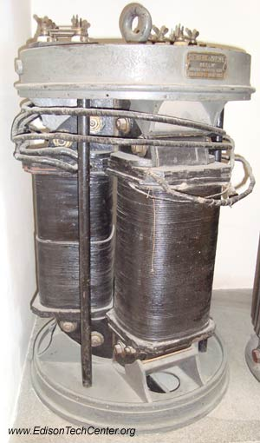
1891
Early three phase transformer (circular core type) Siemens and Halske company 5.7 kVA 1000/100 V

Slide 28
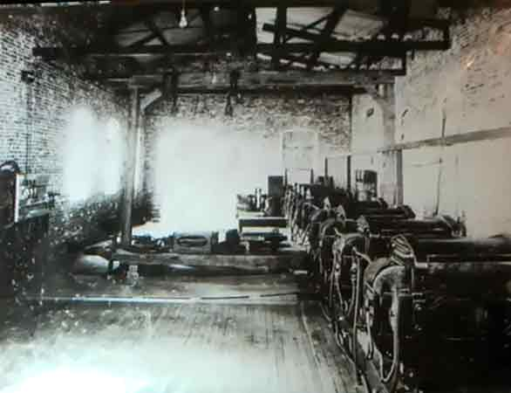
1895
1895 Air cooled transformers built by William Stanley for a three phase AC power station

Slide 29
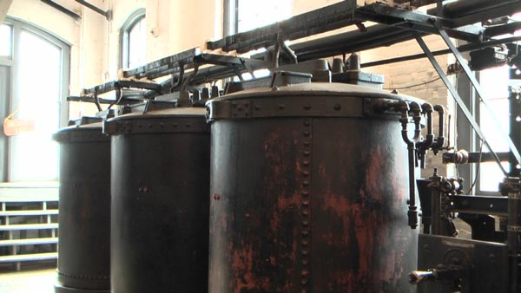
1917
Large Westinghouse transformers from 1917 at the Hydro-power plant at Folsom, California

Slide 30
www.playppt.com

