Slide 1
Basics of HTML
www.playppt.com

Slide 2
What is HTML?
HTML or Hyper Text Markup Language is the standard markup language used to create Web pages.
HTML is written in the form of HTML elements consisting of tags enclosed in angle brackets (like <html>).
HTML tags most commonly come in pairs like <h1> and </h1>, although some tags represent empty elements and so are unpaired, for example <img>.
The first tag in a pair is the start tag, and the second tag is the end tag (they are also called opening tags and closing tags).
A Web browser can read HTML files and compose them into visible or audible Web pages.

Slide 3
History of HTML
The first publicly available description of HTML was a document called "HTML Tags", first mentioned on the Internet by Berners-Lee in late 1991.
It describes 18 elements comprising the initial simple design of HTML.
Eleven of these elements still exist in HTML 4.
After the HTML and HTML+ drafts expired in early 1994, the IETF created an HTML Working Group, which in 1995 completed "HTML 2.0“.
The first HTML specification intended to be treated as a standard against which future implementations should be based.
HTML has been progressively moved in this direction with CSS.

Slide 4
Syntax of HTML

Slide 5
Easy to Use & Understand
Almost anyone in the web development business would know HTML be it a freelancer or a large agency.
It would be relatively easy to find cost-effective and affordable solution providers who can make the changes you need to your website.
Today, XML is increasingly being used for data storage.
The similarity of syntax between HTML and XML means that it is easier and seamless working between the two platforms.

Slide 6
HTML is in XML
The other syntax that can be used for HTML is XML.
This syntax is compatible with XHTML1 documents and implementations.
Documents using this syntax need to be served with an XML media type
namespace following the rules set forth by the XML specifications.
Below is an example document that conforms to the XML syntax of HTML.
<?xml version="1.0" encoding="UTF-8"?>
<html xmlns="http://www.w3.org/1999/xhtml">
<head> <title>Example document</title>
</head> <body> <p>Example paragraph</p>
</body>
</html>

Slide 7
Advantages of HTML
It is widely used.
Every browser supports HTML language.
It is by default in every windows so you don't need to purchase extra software.
Loose syntax (although, being too flexible will not comply with standards).
Widely used in established on almost every website, if not all websites.
Very similar to XML syntax, which is increasingly used for data storage.
Free - You need not buy any software.
Easy to learn & code even for novice programmers.

Slide 8
HTML4 Vs. HTML5

Slide 9
Features of HTML5
Multimedia Support
Video & Audio
New Input Element Types
Canvas in HTML5
Custom Data Attributes
Editable Contents
Autofocus and Placeholder Attributes
Required Field and Range Validators

Slide 10
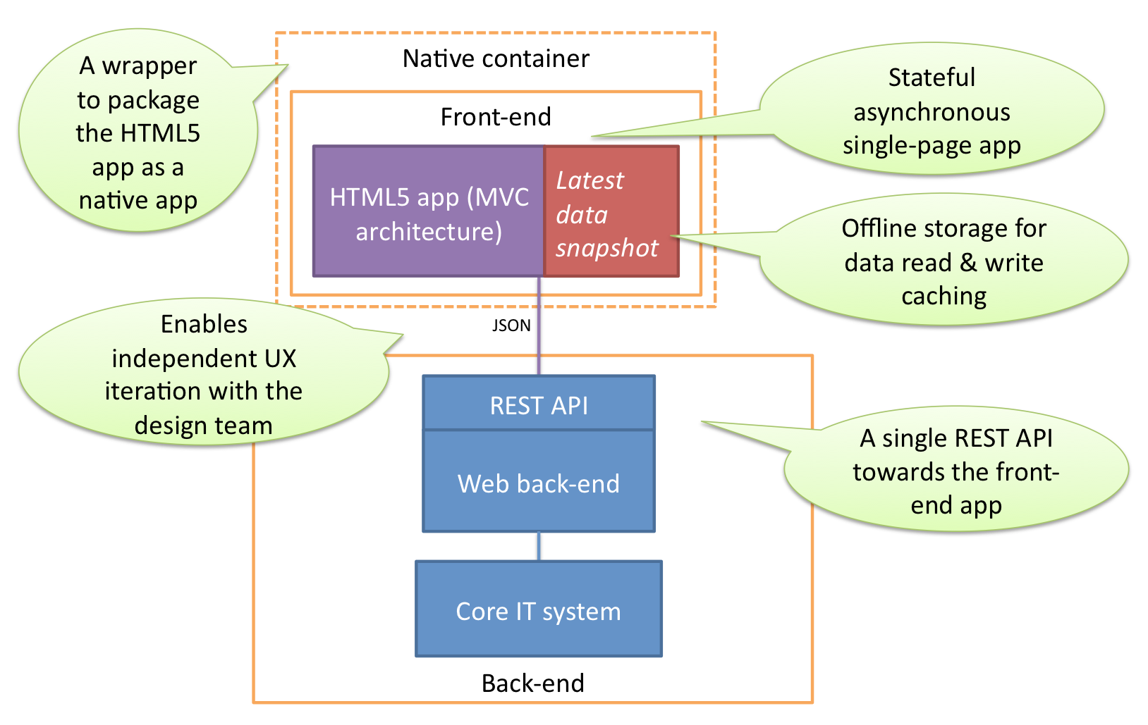
HTML5 Web Architecture

Slide 11
Advantages of HTML5
Mutuality
Leaner markup / Improved Code
Improved Semantics
Elegant forms
Improved Accessibility & Consistency
Offline Application cache
Geo Location Support
Client-side database

Slide 12
Thank You
www.playppt.com

